Slide 1

MAXIMIZING REVENUE FOR DRIVERS USING STATISTICAL ANALYSIS
- Akshata Agine

Slide 2
AGENDA
Problem Statement
Research Question
Data Overview
Methodology
Analysis & Findings
Hypothesis Testing
Recommendations

Slide 3

PROBLEM STATEMENT
In the competitive taxi booking industry, maximizing revenue is key for long-term success and driver satisfaction.
Our data-driven research explores the impact of payment methods on fare pricing, focusing on the relationship between payment type and fare amount to uncover insights that boost driver earnings.

Slide 4
RESEARCH QUESTION
Is there a relationship between the total fare amount and payment type?
Can we nudge customers towards payment methods that generate higher revenue for drivers, without negatively impacting customer experience?

Slide 5
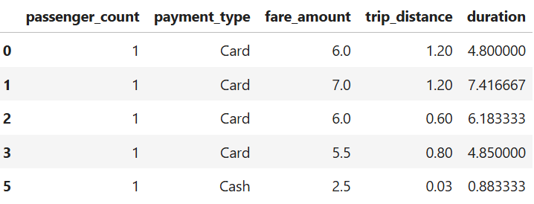
DATA OVERVIEW
We used NYC Taxi trip records for this analysis, applying data cleaning and feature engineering to focus on key columns relevant to our investigation.
passenger_count --- (1 to 5)
payment_type --- (Card/Cash)
fare_amount --- ($)
trip_distance --- (miles)
Duration --- (minutes)

Slide 6
METHODOLOGY
STEP | DESCRIPTION
Descriptive Analysis | Summarized key data features with a focus on fare amounts and payment types through statistical analysis.
Hypothesis Testing | Conducted a t-test to evaluate if payment methods significantly impact fare amounts.
Regression Analysis | Linear regression was used to examine the relationship between trip duration and fare amount.

Slide 7
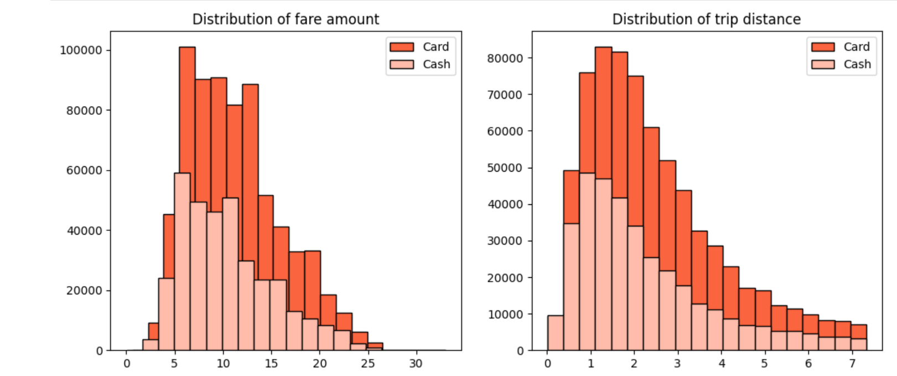
JOURNEY INSIGHTS
 | Payment Type | Mean | Standard Deviation
Fare Amount | Card | 11.3 | 4.8
 | Cash | 10.5 | 4.8
Trip Distance | Card | 2.5 | 1.6
 | Cash | 2.2 | 1.6
Card-paying customers have slightly higher average trip distances and fare amounts compared to cash-paying customers.
This suggests customers prefer using cards for longer trips and higher fares.

Slide 8
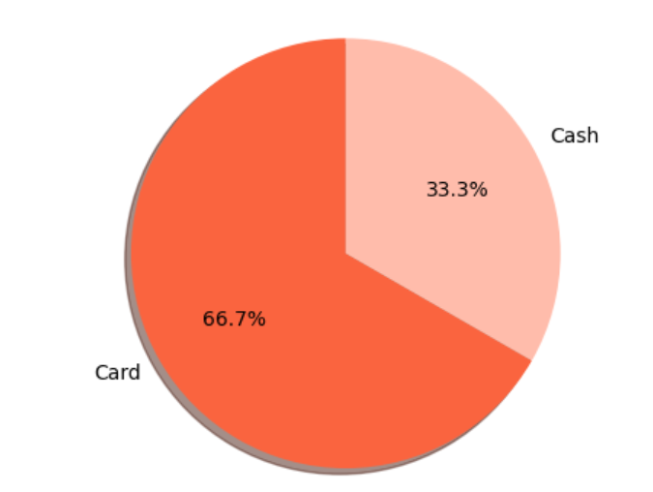
PREFERENCE OF PAYMENT TYPES
The proportion of customers paying with cards is significantly higher than those paying with cash, with card payments accounting for 66.7% of all transactions compared to cash payments at 33.3%
This highlights a customer preference for card payments, likely due to convenience, security, or incentives.

Slide 9
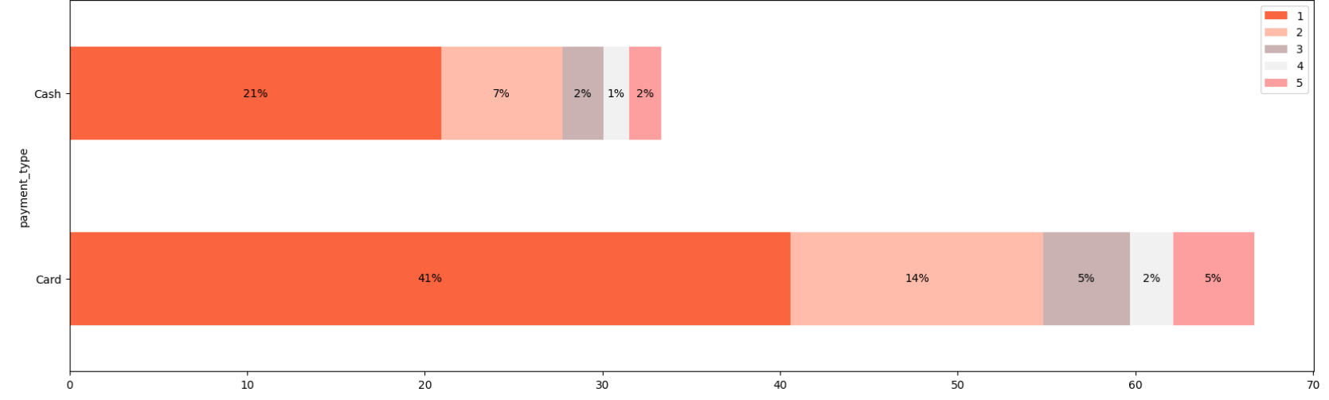
PASSENGER COUNT ANALYSIS
Single-passenger rides account for 41% of card transactions and 21% of cash transactions.
As passenger count increases, the percentage of transactions declines, indicating larger groups are less likely to use taxis or may choose other payment methods.
These insights highlight the importance of considering both payment method and passenger count to understand customer behavior and preferences better.

Slide 10
HYPOTHESIS TESTING
Null Hypothesis: There is no difference in average fare between customers who use credit cards and customers who use cash.
Alternate Hypothesis: There is a difference in average fare between customers who use credit cards and customers who use cash.
With a T-Statistic of 165.5 and a p-value of less than 0.05, we reject the null hypothesis, suggesting that there is indeed a significant difference in average fare between the two payment methods

Slide 11



RECOMMENDATIONS
Offer incentives or discounts to promote credit card usage.
Ensure secure and convenient credit card options to increase adoption.
Encourage credit card payments to boost driver revenue.

Slide 12
THANKYOU!

